Slide 1
Spain
By Kayle Heinzelman and Maddie Lamanna

Slide 2
Location
Absolute location- 40.333*N, 3.7000*W
Relative location- North Atlantic ocean, Bay of Biscay, and pyreneens.

Slide 3
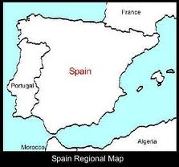
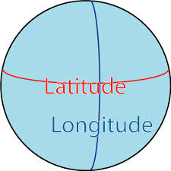
Relative absolute

Slide 4
Place
Human features- strong influence upon Latin American music Sagrda FamiliaChurch drew people Gaudi a famous Architech lives
Physical features- the beaches, mountains, and flat lands.

Slide 5
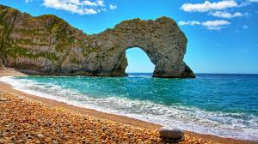
Physical Marriott beach

Slide 6
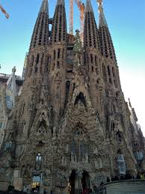
Human features
This Is a really famous church that many
People from all over come to.

Slide 7
movement
People move- by a plane, bus, train.
Goods move- by boats, trucks, cars.
Ideas move- by telephone, email and sometimes mail.

Slide 8
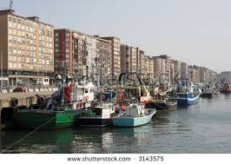
Goods move
This is a boat that they
Use to move goods.

Slide 9
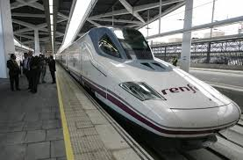
People move
This is a underground subway
This is how people go from place
To place.

Slide 10
Ideas move
This is a telephone that people use to
communicate

Slide 11
Human-environment interaction:
People affect the environment by building factorys, littering, and they pollute the air.
Environment affects the people beucase the weather changes, the weather gets to bad and forces the crops to go bad forces the people to wear different clothing.

Slide 12
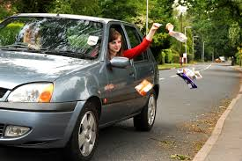
People effecting land
This a girl who lives in
Spain who is littering .

Slide 13
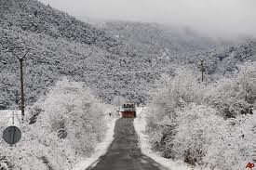
Environment affects people
This is very cold weather
That is affecting spain.

Slide 14
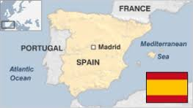
region
Religious country comminted to roman cathoic many of houses are dwelling in spain are that share spare with chemicals.
This picture shows that spain
Is very religious.

Slide 15
Tourist attractions
Magic mountains of montjoic, iibiea, and park guelll.

Slide 16
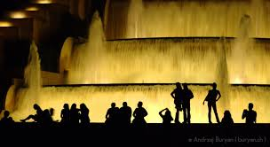
Magic fountain
This is the magic fountain in spain

Slide 17
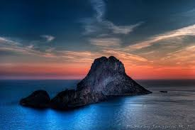
Ibiza bay
This is a famous bay in spain

Slide 18
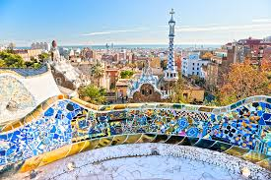
Park Guell
This is a park In spain

