Slide 1
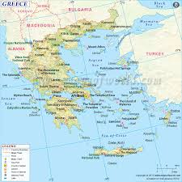
Greece
By Karen Whalen, Kayla Moskowitz,
And Patrick Casterline

Slide 2
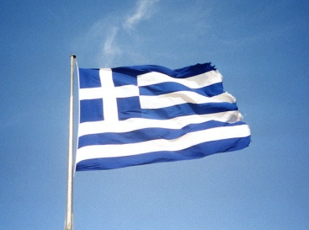
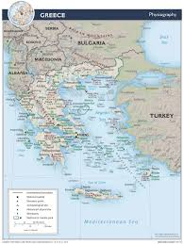
Location
RELATIVE-
Greece is under bulgaria , macedonia, and albania. near turkey. Also water boundaries are the Mediterranean sea ,ionian sea, and aegean sea.
Absolute-
The absolute location of athens, greece is 38 degrees north and 24 degrees east.

Slide 3
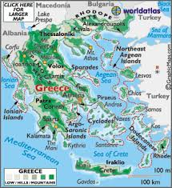

Slide 4
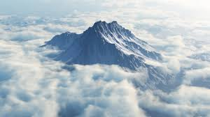
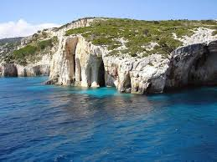
Place
Human features-
greece has historical monuments, ancient houses, and ancient delos.
Physical features-
mountains such as mount olympus. Seas such as the lonian sea, and agean sea . Greece is the southernmost part of the balken peninsula.

Slide 5
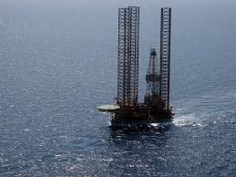
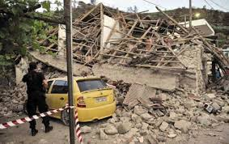
Human Environment Interaction
People affecting environment
Oil drilling, Cutting trees, Cars using carbon dioxide…
Environment affecting people
Hurricanes causing destruction, trees blocking wind from the ocean, fish for food

Slide 6
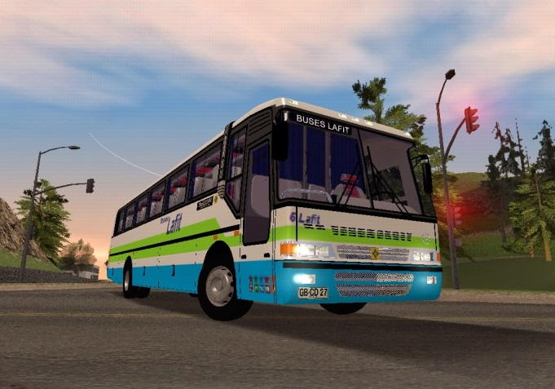
Movement
People move-
buses, cars, and bikes
Goods move-
Railways, ships, and trucks
Ideas move-
talking online, cell phones, Tv, and radios

Slide 7
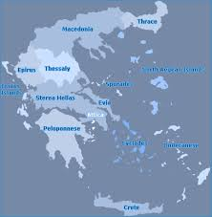
Region
A few of Greece’s regions are …
Central greece
n. East island
Ionian islands

Slide 8
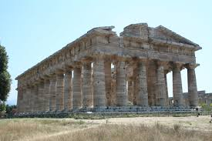
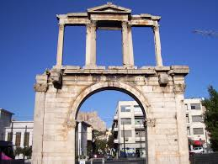
Tourist Attractions
Venetian fortress
Temple of poseidon
Handrians arch

Slide 9
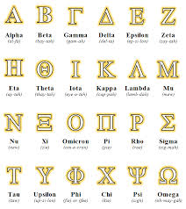
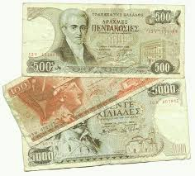
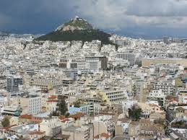
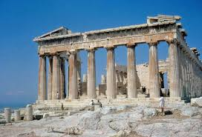
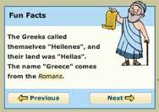
Greece…
Greek money
Greek Alphabet
Athens, Greece
Athens, Temple of Olympian Zeus

