Slide 1
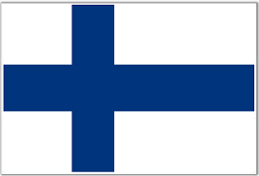
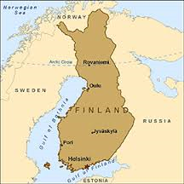
Finland
By Sarah, RJ ,an Nick F

Slide 2
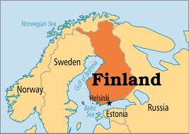
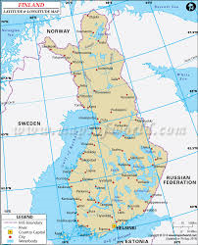
Capital
The capital is Helsinki, Finland
The absolute location of the capital is: 60° 10' N, 24° 56' E

Slide 3
Absolute and relative location
Absolute: the absolute location is 6400 degrees North and 2000 degrees East
Relative: next to Sweden, next to Russia , and bordering the Baltic sea

Slide 4
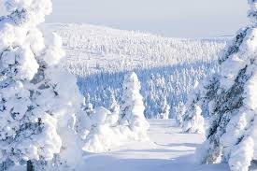
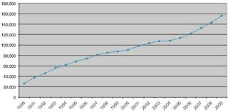
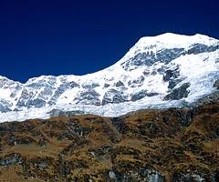
region
Finland is snowy and cold but it is fun sledding and making snowman.
join are 5.4 million people and have fun.
Land: It might be a little rigid and snowy but have fun climbing these rigid mountains.

Slide 5
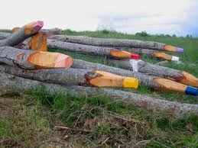
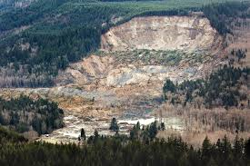
HEI
people affecting the environment: one way is they are cutting down trees to make art like giant crayons.
environment affecting the people: one way is the ground is soft and is collapsing and killing people. But in a way it make a master piece.

Slide 6
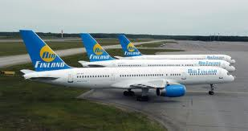
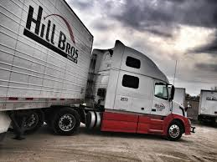
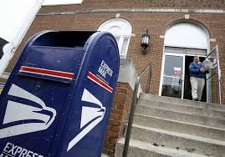
movement
You can move by car and you can get there by air plane it might cost a lot but it’s worth it.
a lot of the things that you see in your stores are transported by Finland.
Stay connected with your family and friends with mail, text, and you can meet new friends in Finland.

Slide 7
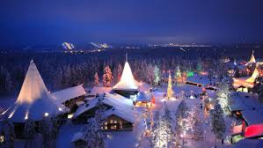
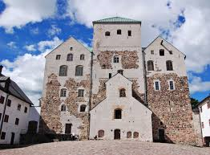
place
One place you should visit during Christmas time is Santa Claus Village
The Turku is one of the oldest places in Finland and you should pay it a visit.

Slide 8
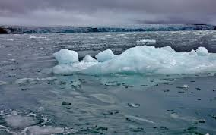
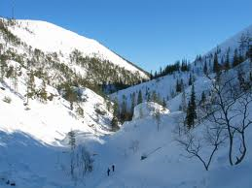
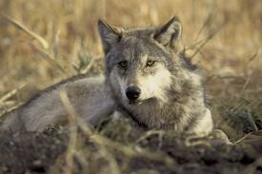
Physical features
Land forms: the land forms may be cool but it is mostly what it is it is mostly covered with glaciers
the climate is mostly sub polar climate.
Plant/animal: the plants are mostly maple and elm trees . And the animals are mostly woodland animals like squirrels, rabbit, wolfs, coyote, and more.

Slide 9
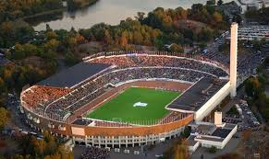
Tourist attractions
One huge tourist attraction is the Helsinki Olympic Stadium where the Olympics were hold in the 1952.

