Slide 1
EASTERN EUROPE

Slide 2
Miscellaneous
Religions
There are 3 prominent religions practiced in Eastern Europe since the collapse of the USSR.
1. Catholic
2. Eastern Orthodox
3. Muslim (from the Ottoman Empire)
Result of Great Schism

Slide 3
(Cont.)
In 1054 the leaders of the Catholic Church in the west (old Roman Empire) and the east (Byzantine Empire) agreed to disagree on 4 key issues (head of the church, marriage of clergy, use of icons and celebration of religious holidays Christmas and Easter) thus splitting the Catholic Church. The church in the west remained the Catholic Church and in the east it became the Eastern Orthodox Church. This split was known as the Great Schism.

Slide 4
Economies
Economies are struggling
- due to so many years under Communism.
1. Inexperience at self governing – after being under Soviet control for so long, they did not know how to govern themselves after receiving independence.
2. Unstable governments discourages economic growth. No one wants to do business with a group that is unstable. No assurance that they can trust them and an overthrow of government can happen at any time.

Slide 5
Economies (cont.)
3. Lack of diversity- under Communism each country contributed her resources (agriculture, mineral wealth, shipping and/or industry, etc) to the good of Mother Russia. What they lacked was supplied by the USSR. Since their independence, these countries need to be able to do everything not just one or two.
- Some nations have made the transition better than others.

Slide 6
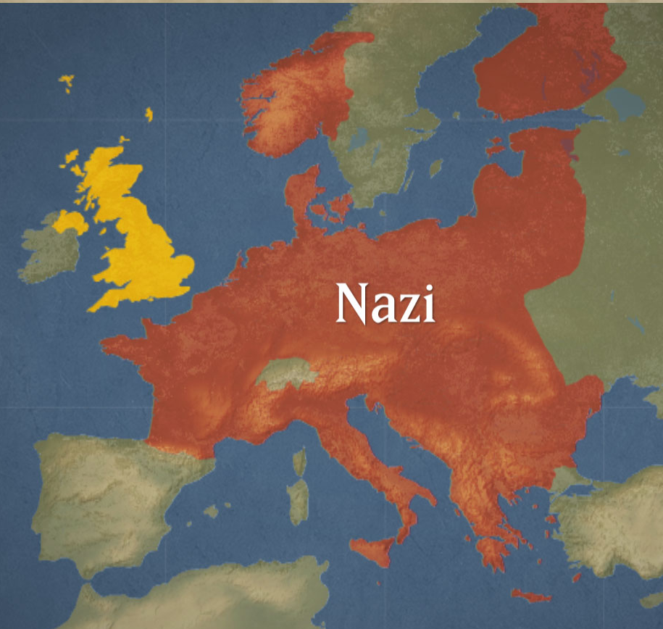
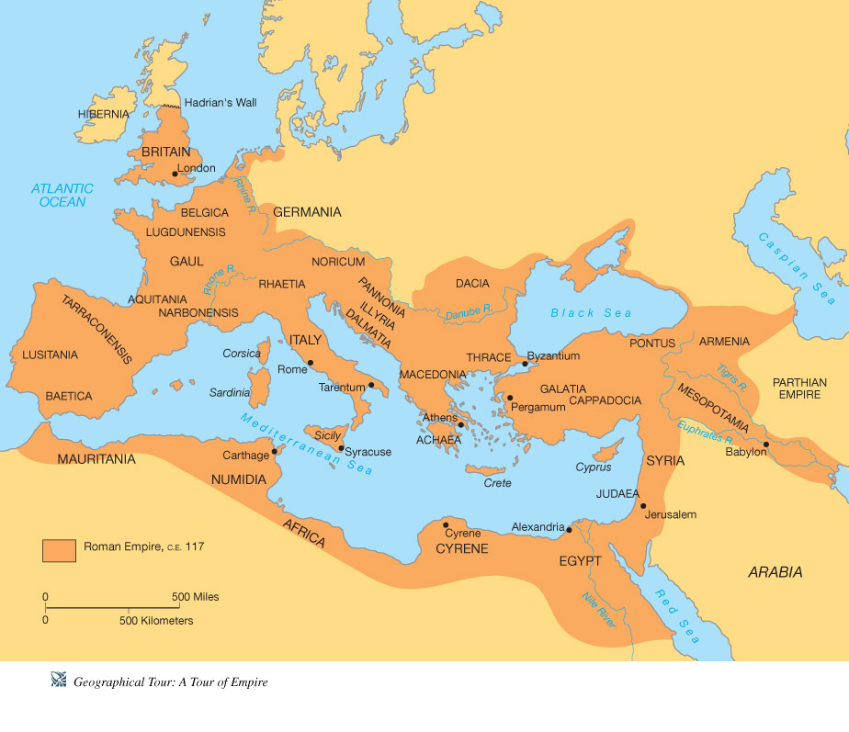
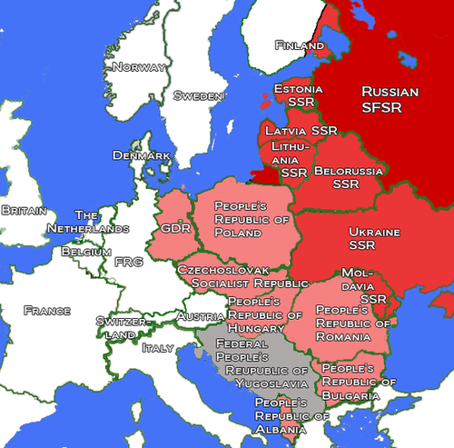
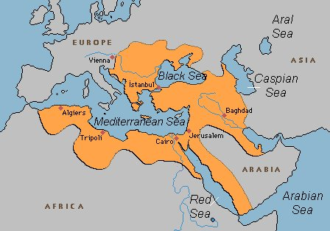
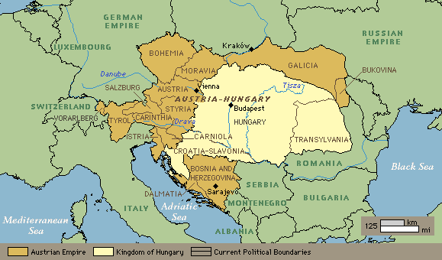
HISTORY
Most Eastern European countries have had limited experience with self government because for 2000 yrs. they were under the control of various empires.
1. Romans
2. Byzantine Empire
3. Ottoman Empire
4. Austro-Hungarian
5. Nazi Germany
6. U.S.S.R.
Roman
Ottoman
Soviet Bloc
Austro Hungarian

Slide 7
The nations of Yugoslavia and Czechoslovakia were
created following WWI as the victors carved up the
defeated German and Austro-Hungarian Emp.
Also the nations of Poland, Hungary, Romania and Bulgaria regained their independence after WWI.

Slide 8
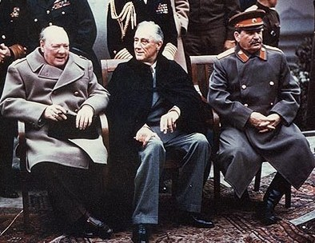
Sadly this period of “freedom” lasted only 21 yrs.
Yalta Conference of 1945 allowed the Soviets to
control eastern Europe

Slide 9
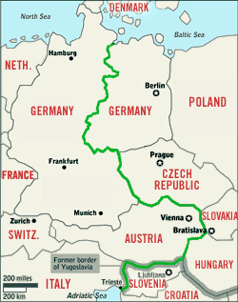
During the Cold War (1945-89) the majority of eastern European countries were part of the Soviet Bloc with the exception of Yugoslavia and Albania. They were communist, but not part of the USSR
Boundary between eastern and western Europe was
the Iron Curtain.
In 1980 Mikhail Gorbachev was
elected Pres. of the USSR. He
introduced the policies of
perestrokia and glasnost
Only need to listen to the first 35 seconds!

Slide 10
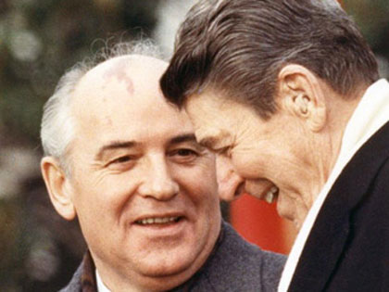
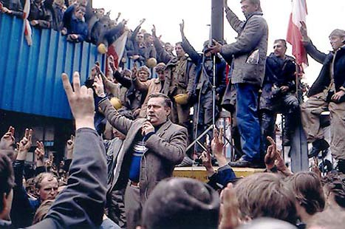
Gorbachav
The breakup of the USSR
was a grassroots movement
which
began in Poland with
the dock workers under
the leadership of Lech
Walesa
Pres. Reagan

Slide 11
Questions A
Which church allows it priests to marry?
When does the Orthodox Church celebrate Christmas?
List three reasons/causes of Soviet expansion after WWII.
Why wasn’t Yugoslovia under Soviet control?
Use this site to compare the percapita GDP of Czech Republic with that of Moldova . What is their ranking in world economies?
6. Define glasnost and perestrokia?
7. Why were they implemented?
8. The Polish Solidarity movement had the support of what three groups?
9. What was the initial reason for the strike?
10. Define grassroots movement.

Slide 12
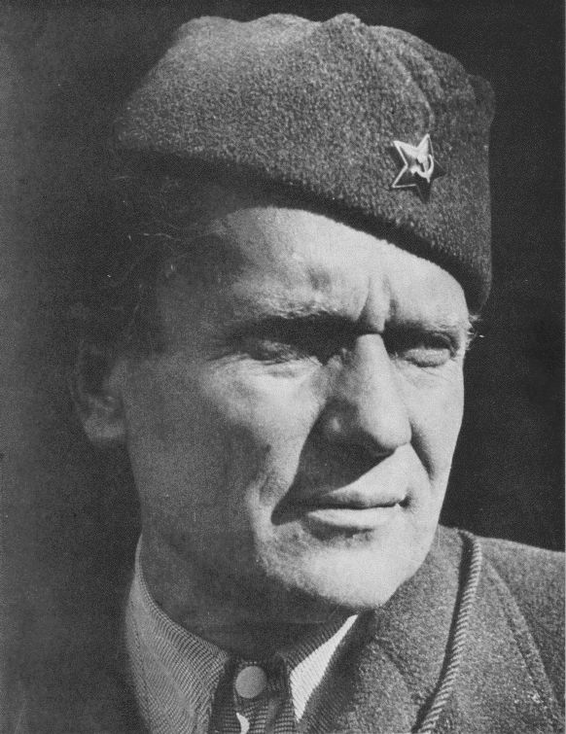
Issues prominent in E. Europe
1. Nationalism (Listen only to the definition 1:41)
- Nationalism is often thought of as patriotism (pride in one’s
country). What if a group of people with a common ethnicity
do not have a country (land) and do not govern themselves?
- In E. Europe there are many ethnic groups who were subject to a
government that did not share their ethnicity. Therefore, the
definition we will be working with is; Nationalism is the desire of
an ethnic group to be governed by someone of like ideology and
belief
- This situation was especially an issue in the former Yugoslavia
- After WWI, 3 ethnic groups were lumped into 1 country under the
dictatorship of General Tito.
- Tito’s iron-fisted rule kept the 3 groups under control but trouble was
brewing just beneath the surface.
- The worst situation was in Bosnia.
General Tito

Slide 13
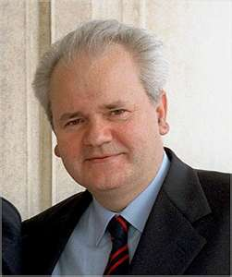
Nationalism @ it’s worst:
Case Study Bosnia
The 3 ethnic groups were:
- Croats- Catholic, western culture (blue on map)
- Serbs- Eastern Orthodox, eastern culture (red)
- Slavs- Muslim, eastern culture (green)
Under the leadership of Slobadan Milosevic (Serb), President of Yugoslavia, the Serbs practiced ethnic cleansing

Slide 14
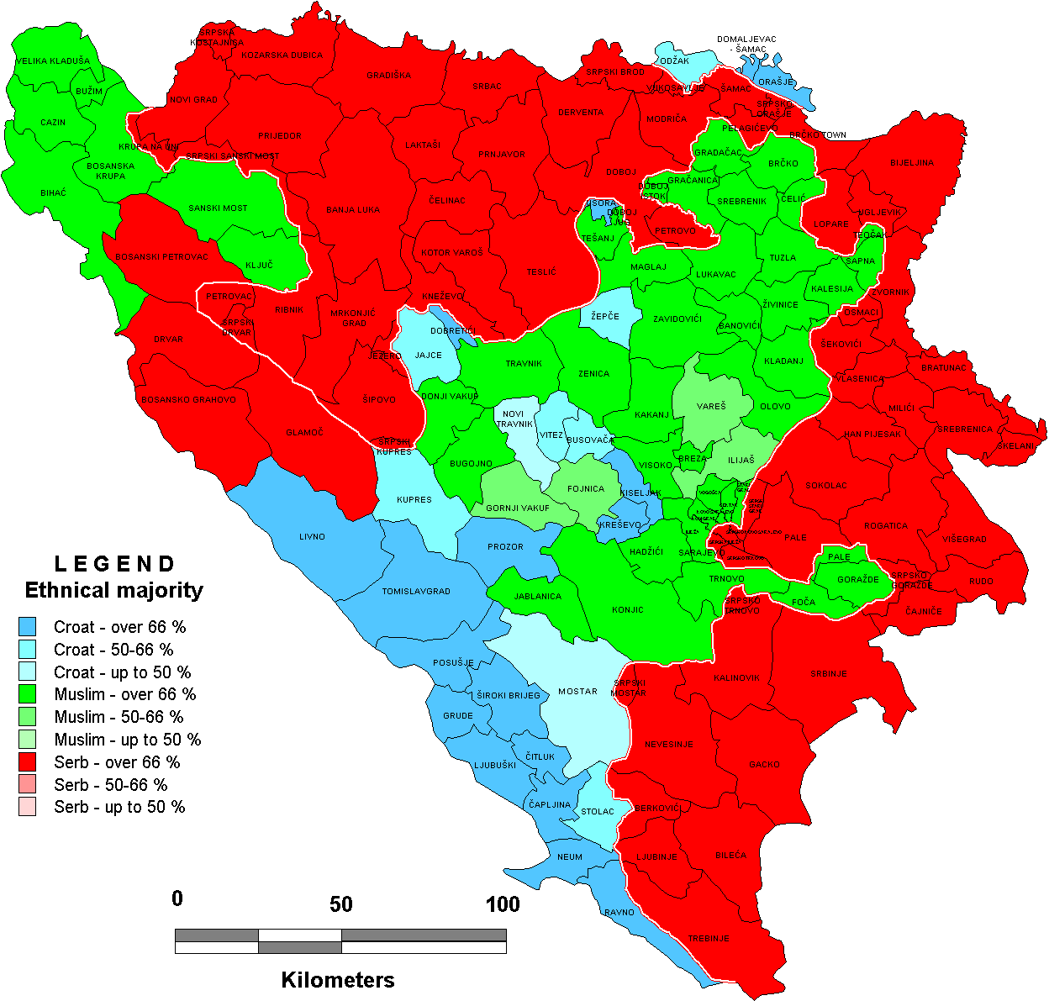
Nationalism @ it’s worst:
Case Study Bosnia
Nato and peace keeping troops were called in to keep the Serbs from
accomplishing genocide
Sadly, Bosnia and E.Europe are not the only
locations in the world where nationalism is
at the root of conflict and war.

Slide 15
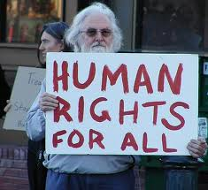
Human Rights Violations
- the right of people everywhere to enjoy freedom from persecution, right to education, health,adequate living standards, work under favorable conditions
- Monitored by the United Nations and other
international organizations.
- Typical “punishment” is sanctions and then military
intervention.

Slide 16
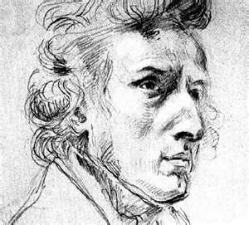
COUNTRIES
COUNTRIES
Baltic States- Estonia, Latvia, Lithuania
Poland
- Capital: Warsaw
- Hitler’s rapid invasion of Poland in Sept. 1939 began WWII
- Nazi death camps because
1. Already a large Jewish population ( Warsaw Ghetto)
2. Hitler wanted to keep the knowledge of what he was doing to the Jews
from the German people as long as possible.
- Famous composer- Chopin (if only)

Slide 17
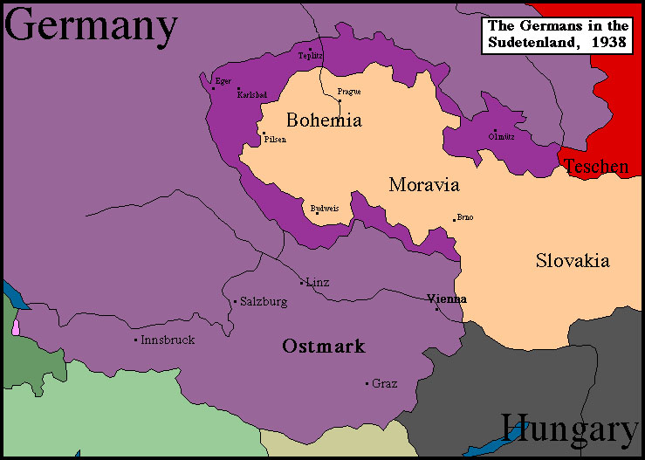
COUNTRIES
COUNTRIES
Czech Republic ( formerly known as Bohemia)
- Capital: Prague
- Sudetenland – bordering region of Czechoslovakia
populated by German-speaking people. Hitler
invaded in 1938 despite his promises not to.

Slide 18
Slovakia
- split with Czech Republic in 1993
- no further reforms have been made, dictatorship
Hungary
-Capital- Budapest
Bulgaria
- Capital- Sophia

Slide 19
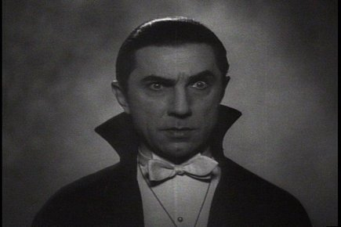
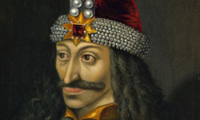
Romania (Land of the Romans)
- Capital Bucharest
- Transylvania/ Count Dracula (was he real?)
- Ceausescu (find out more about him)

Slide 20
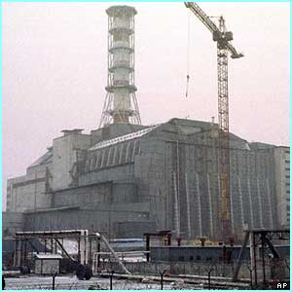
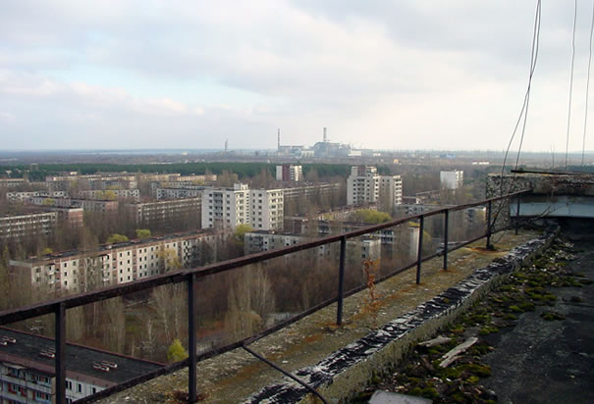
Moldova
- ongoing border dispute with Romania
- lowest per capita GDP $2,500
Ukraine “Breadbasket of the USSR”
- Capital- Kiev
- Heavily industrialized
- Chernobyl 1986- “straw that broke the back”

Slide 21
Belarus
- Capital- Minsk
- Drifting back toward a dictatorship and comm.
Macedonia – famous person- Alexander the Great
Albania

Slide 22
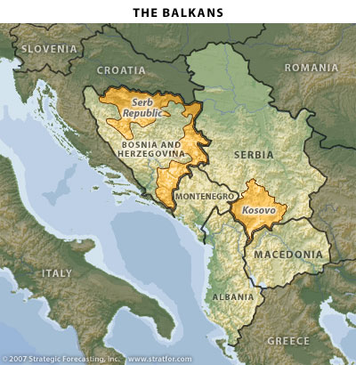
Slovenia
Croatia
Serbia
- Capital - Belgrade
- ethnic cleansing
Bosnia
-Capital- Sarajevo
Kosovo
- Capital- Pristina
Montenegro

