Slide 1
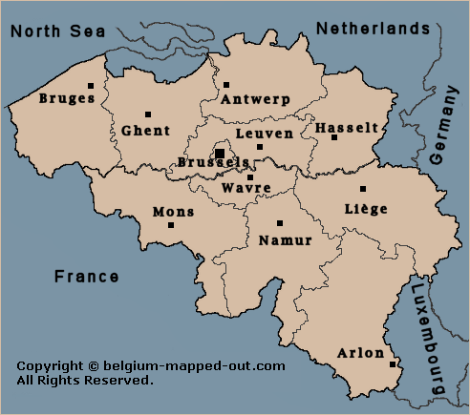
Belgium
by Logan goudreau and Jake HENRY

Slide 2
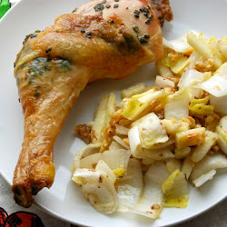
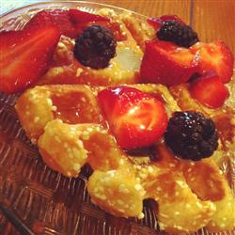
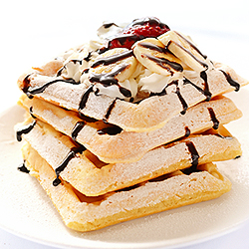
Quick facts
The capital of Belgium is Brussels.
Belgium’s favored food is Sage-Roasted Chicken with Endive Sala
Their best breakfast food/dessert is the Belgian waffle

Slide 3
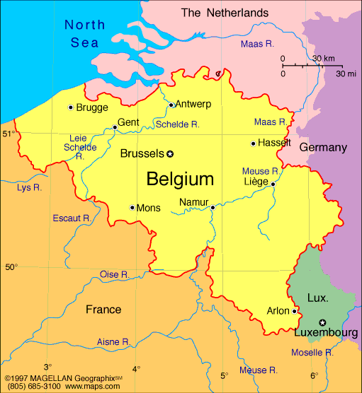
Location
-----ABSOLUTE--------
Latitude of Brussels is 50* 47’ N
Longitude of Brussels is 4* 21’ E
-----RELATIVE----------
Western Europe, bordering the North Sea, between France , Germany , Netherlands, Luxembourg

Slide 4
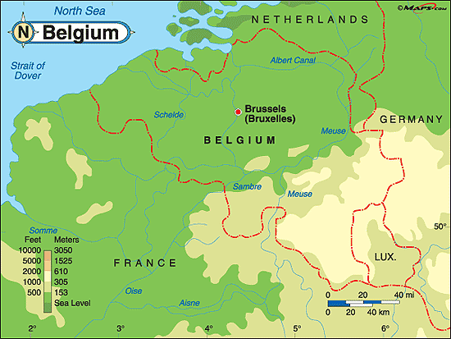
Place
---------PHYSICAL FEATURES---------------
Brussels is an average of 5*C or 41*F in January
In July or August it is 23*C or 74*F
There are also the coastal plains, central plateau, and there are also sandy beaches and polders

Slide 5
Human-environment interaction
---------People to environment---------
Nuclear radiation in the ground making farming almost impossible
--------Environment to people---------
The Atlantic sturgeon are mysteriously dying meaning less fish for some people

Slide 6
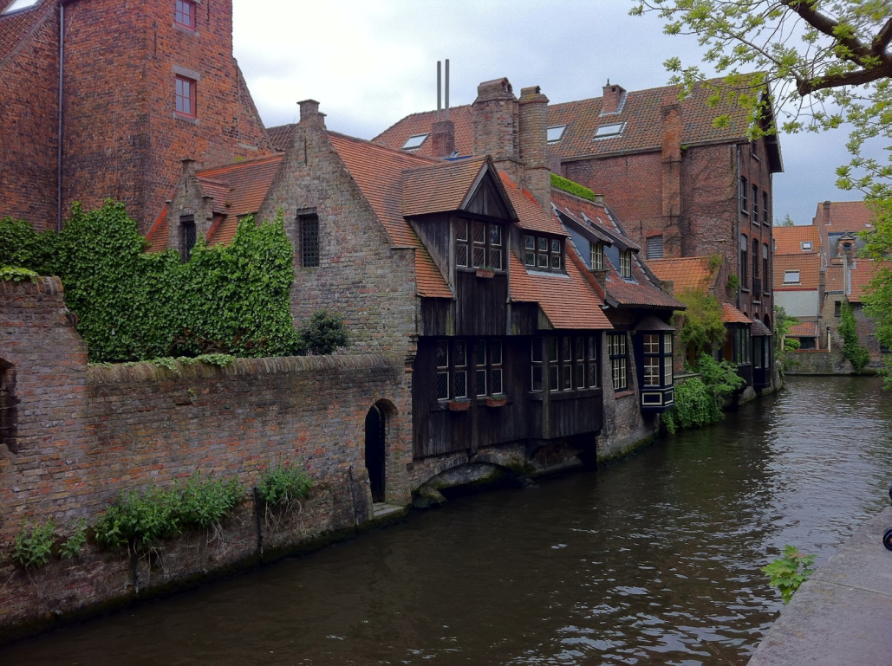
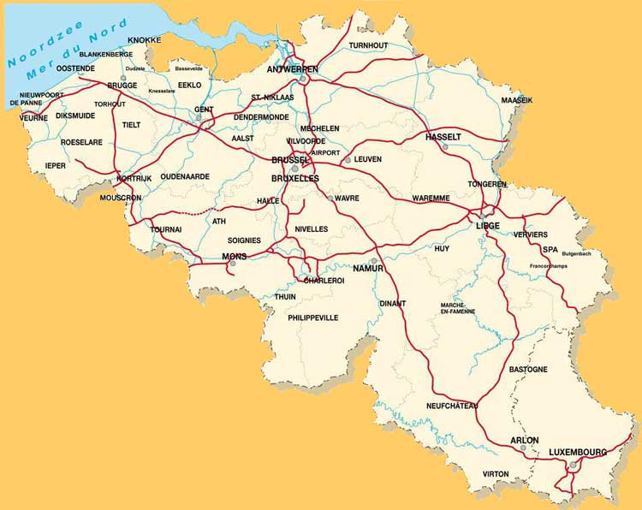
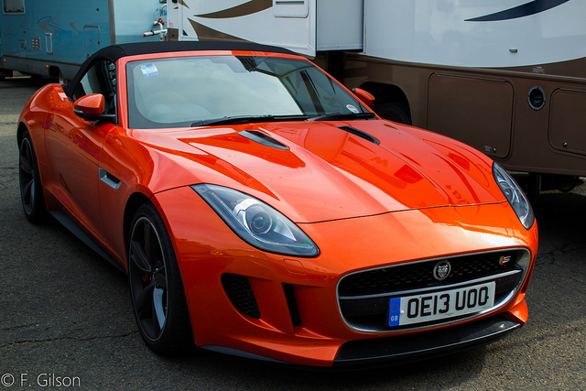
movement
-----People move------
Cars, bikes, train, or by foot
-----Goods move-------
Railroads, expressways, and canals
-----Ideas move--------
Mail, verbally, telephone

Slide 7
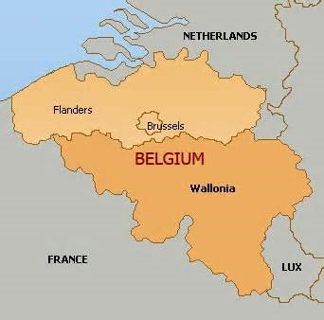
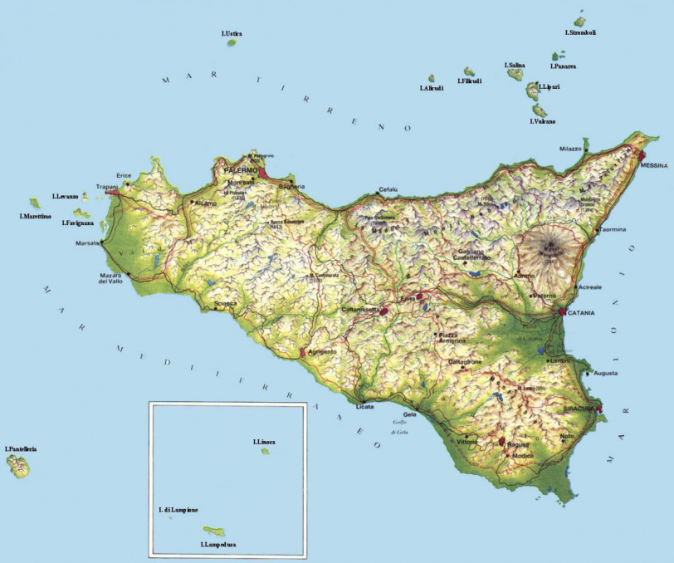
region
-------AREA OF BELGIUM--------
30.528 km squared
11.760 mi squared
------- Other facts[-_-]-------------
20% larger than Sicily
Has 3 official languages SICILY

Slide 8
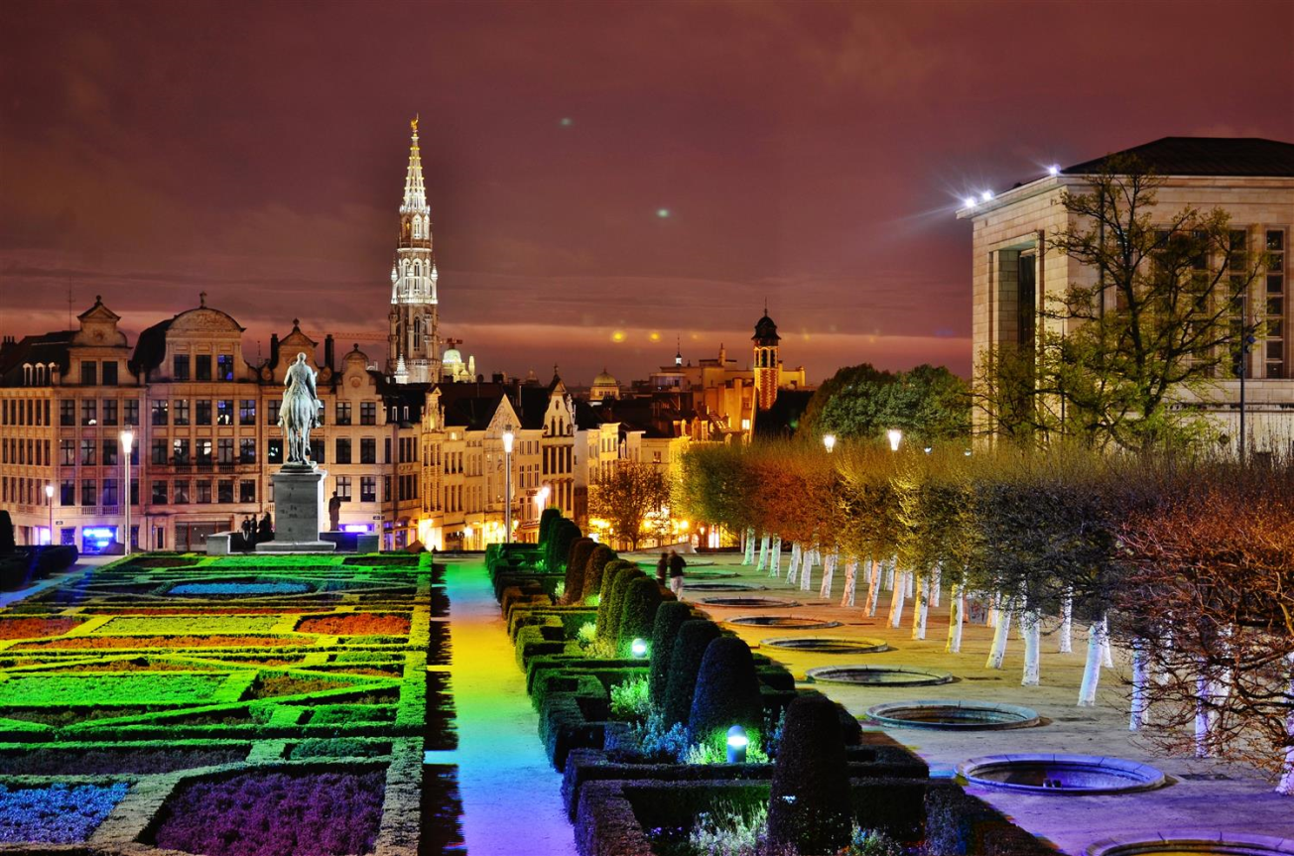
Tourist attractions
Royal Art and History Museum
Guild Houses
Belgian Royal Museum of Fine Arts
Mont des Arts (has a rainbow courtyard)

Slide 9
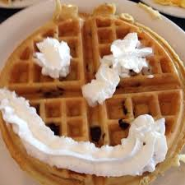
Thank you for watching
We appreciate it! (hope you are hungry!)
Imma waffle eat a pancake instead!

